Slide 1

KTO KARATAY UNIVERSITY
FACULTY OF ENGINEERING
MECHATRONICS ENGINEERING DEPARTMENT
MEM622 FEEDBACK CONTROL SYSTEMS
PROJECT PRESENTATION
MUSTAFA POLAT
MUSTAFA URGAN
200313008
200313017
<24.05.2024>

Slide 2
TABLE OF CONTENTS
INTRODUCTION ...………………………………………………………………… 2
PROJECT ..…………………………………………………………………………... 3
DEPARTMENT OF ELECTRIC ..…………………………………………………. 4
DEPARTMENT OF MECHANIC ...……………………………………………….. 6
TRANSFER FUNCTION ...………………………………………………………… 8
PID …………………………………………………………………………………… 9
MATLAB SIMULINK AND GRAPHS WITH PID CONTROLLER ………….. 10
COMPARISON GRAPHS ………………………………………………………… 20
TRANSFER FUNCTION WITH PID AND GRAPHS ………………………….. 22
CONTROLLER PARAMETERS ………………………………………………… 24

Slide 3
INTRODUCTION
This project titled Shaft Starting With Electric Rotor Control System has been prepared in accordance with the Feedback Control Systems course curriculum.
Project Objectives:
To analyze the theoretical knowledge seen in the course on a system or to make a design with this information.
This system or design is modeled mathematically and analyzed through MATLAB Simulink and Simscape software.
To improve ourselves in the face of the problems encountered, to enhance our ability to research and learn.
To learn how to use MATLAB software, to analyze and to compare theoretical and practical knowledge, and to make informed comments.
To integrate a PID controller and use a saturation block to precisely control the speed and position of the system, improving overall system performance.

Slide 4
PROJECT
The project is an electromechanical system consisting of electrical and mechanical parts.
A rotor is connected to the electric DC motor. This rotor provides a rotational movement by moving with the armature current.
The armature in electric motors is a coil rotating in a magnetic field. This coil is wound on a rotating shaft (rotor).
A rigid shaft is connected to this rotor. This shaft has a mechanical part consisting of two masses, a damper element, and a spring element.
The electrical part of the project is inspired by electric motors, and the mechanical part is inspired by the flexible shaft in the MATLAB Simscape library.
A PID controller and a saturation block have been added to the project. This has allowed us to control the speed and position of the system more precisely.
The project was simulated and analyzed through MATLAB Simulink and Simscape by making mathematical calculations.

Slide 5
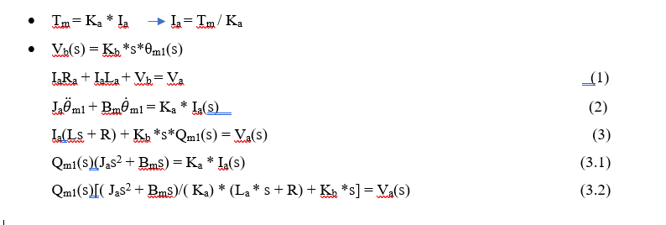
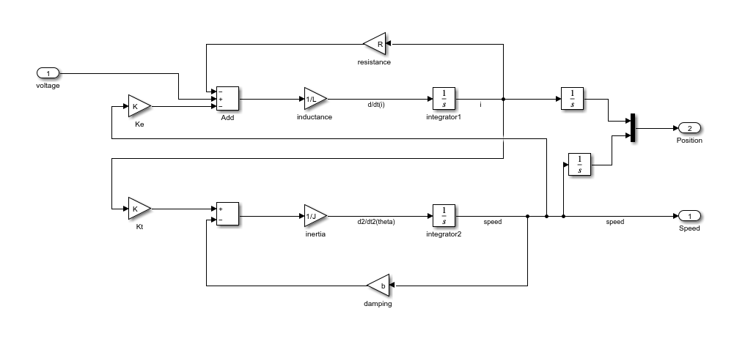
DEPARTMENT OF ELECTRIC
The mathematical model of the electrical part of the project was created and block diagrams were prepared in MATLAB Simulink programme.

Slide 6
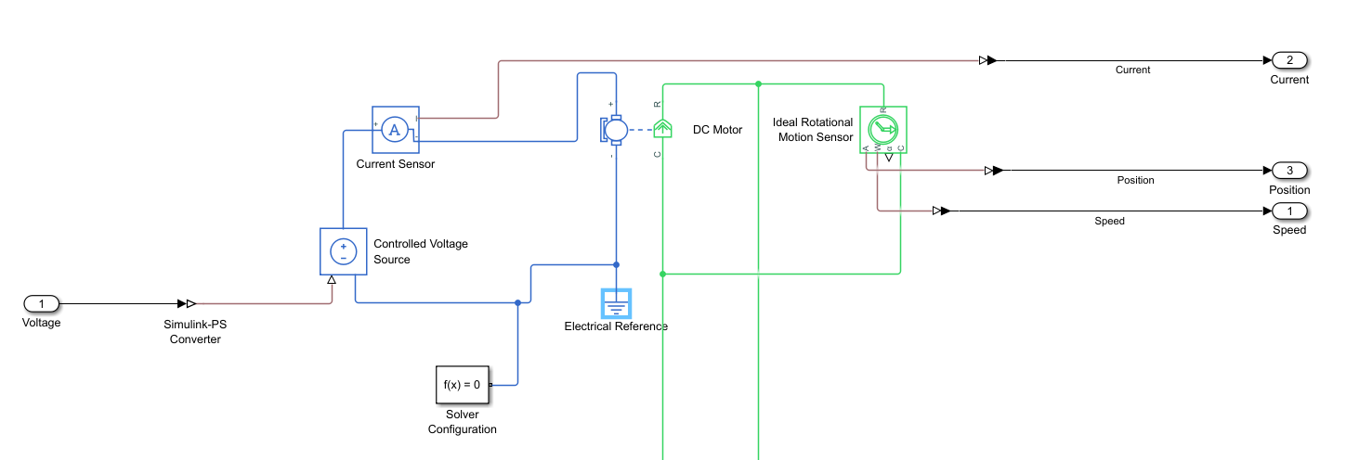
Simscape simulation of the electrical part of the project was prepared by using the library and calculations.
Simscape simulation is shown in the picture below.

Slide 7
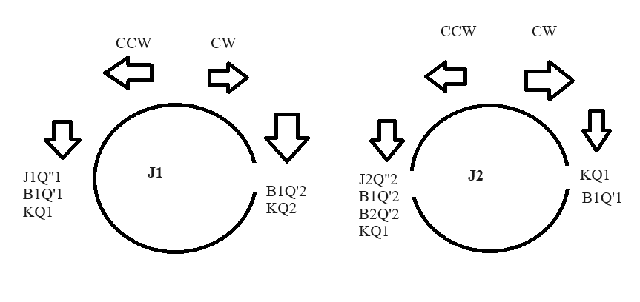
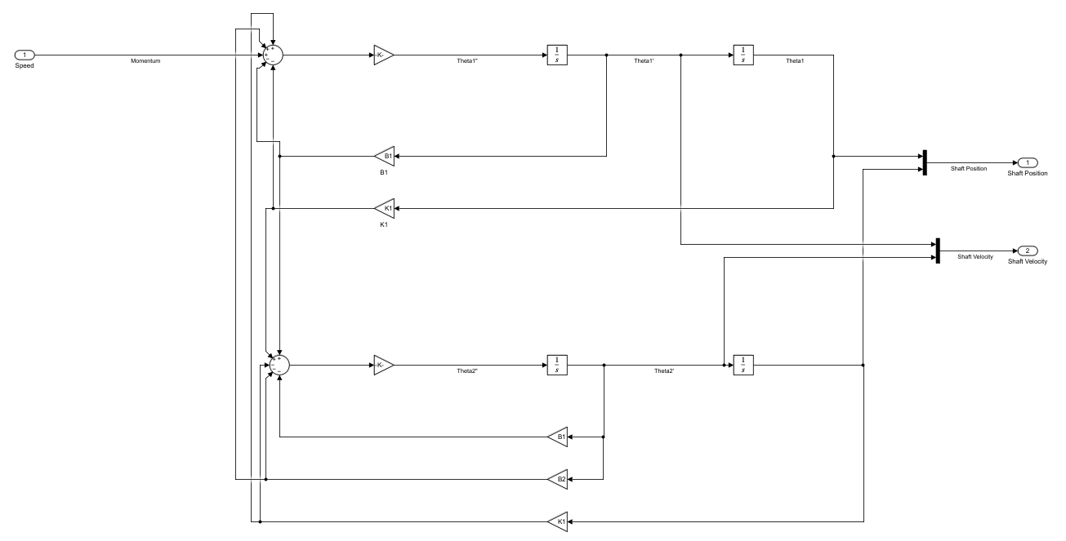
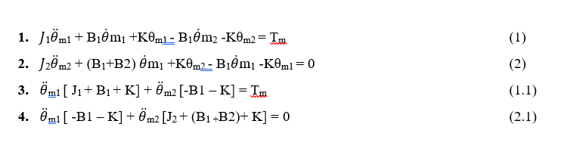
DEPARTMENT OF MECHANICAL
The mathematical model of the mechanical part of the project was created and block diagrams were prepared in MATLAB Simulink programme.

Slide 8
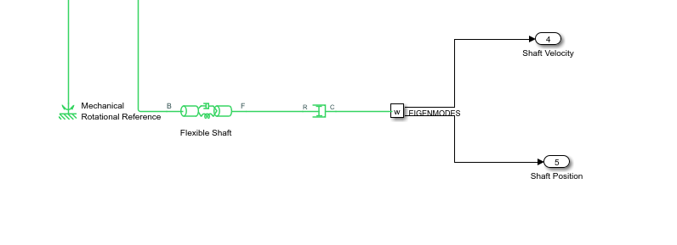
Simscape simulation of the mechanical part of the project was prepared using the library and calculations.
Simscape simulation is shown in the picture below.

Slide 9
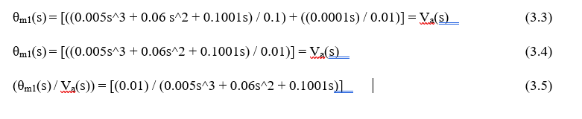
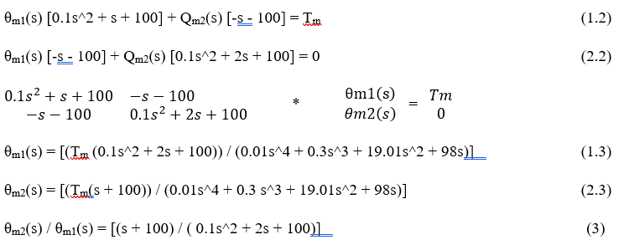
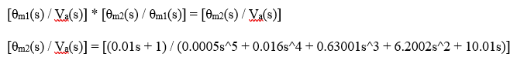
TRANSFER FUNCTION
In the project, the transfer function of the system was calculated using the theoretical knowledge and mathematical calculations seen in the course and compared with Simulink and Simscape outputs.
Electrical Section Transfer Function | Mechanical Section Transfer Function
Transfer Function of Electromechanical System

Slide 10
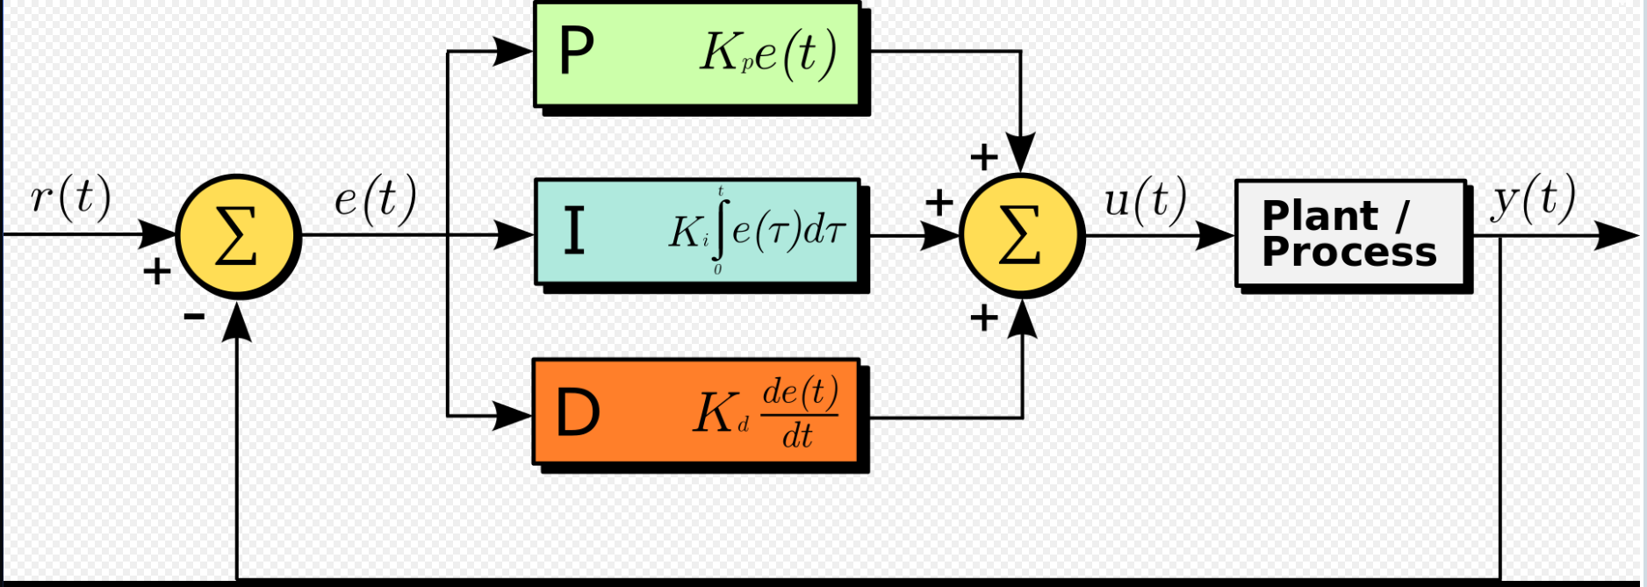
PID
PID, proportional-integral-derivative controller control loop method, is a feedback controller method widely used in industrial control systems. A PID controller continuously calculates an error value, i.e. the difference between the intended system state and the current system state. The controller tries to minimise the error by adjusting the process control input.

Slide 11
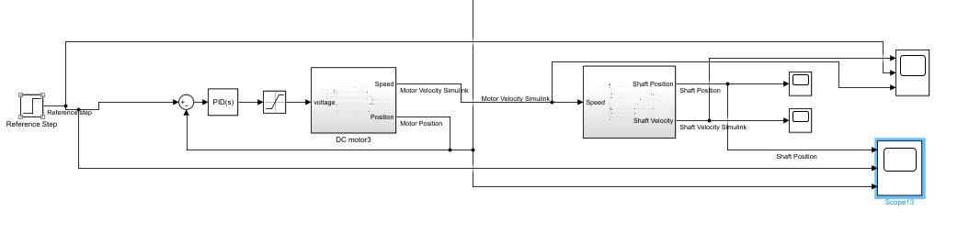
MATLAB SIMULINK AND GRAPHS WITH PID CONTROLLER
In the project, 5 different situations were analysed.
In the first case, the position is controlled with
a fixed input.

Slide 12
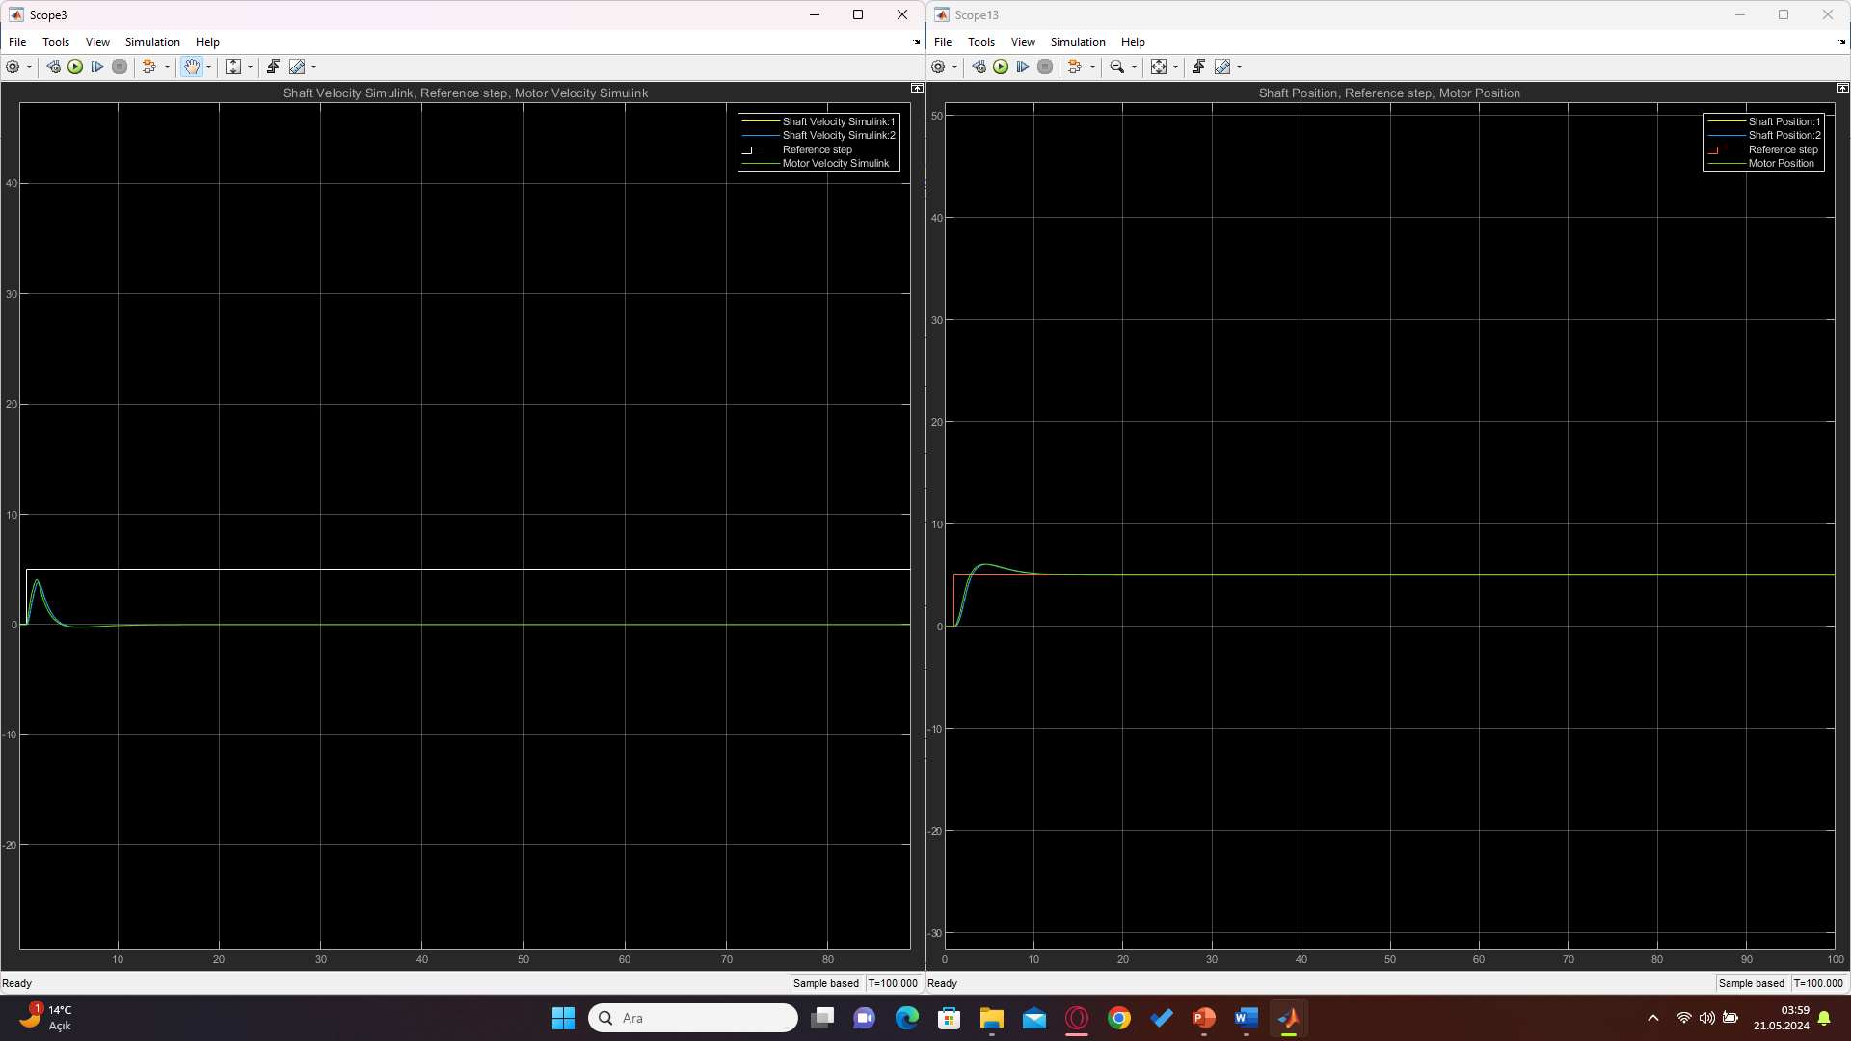
The graph of the position control system with a fixed input is given below.

Slide 13
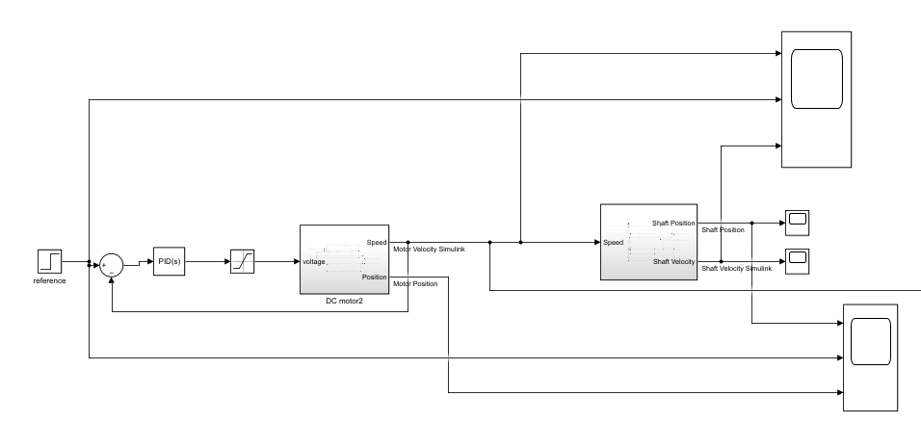
In the second case, the velocity is controlled with a fixed input.

Slide 14
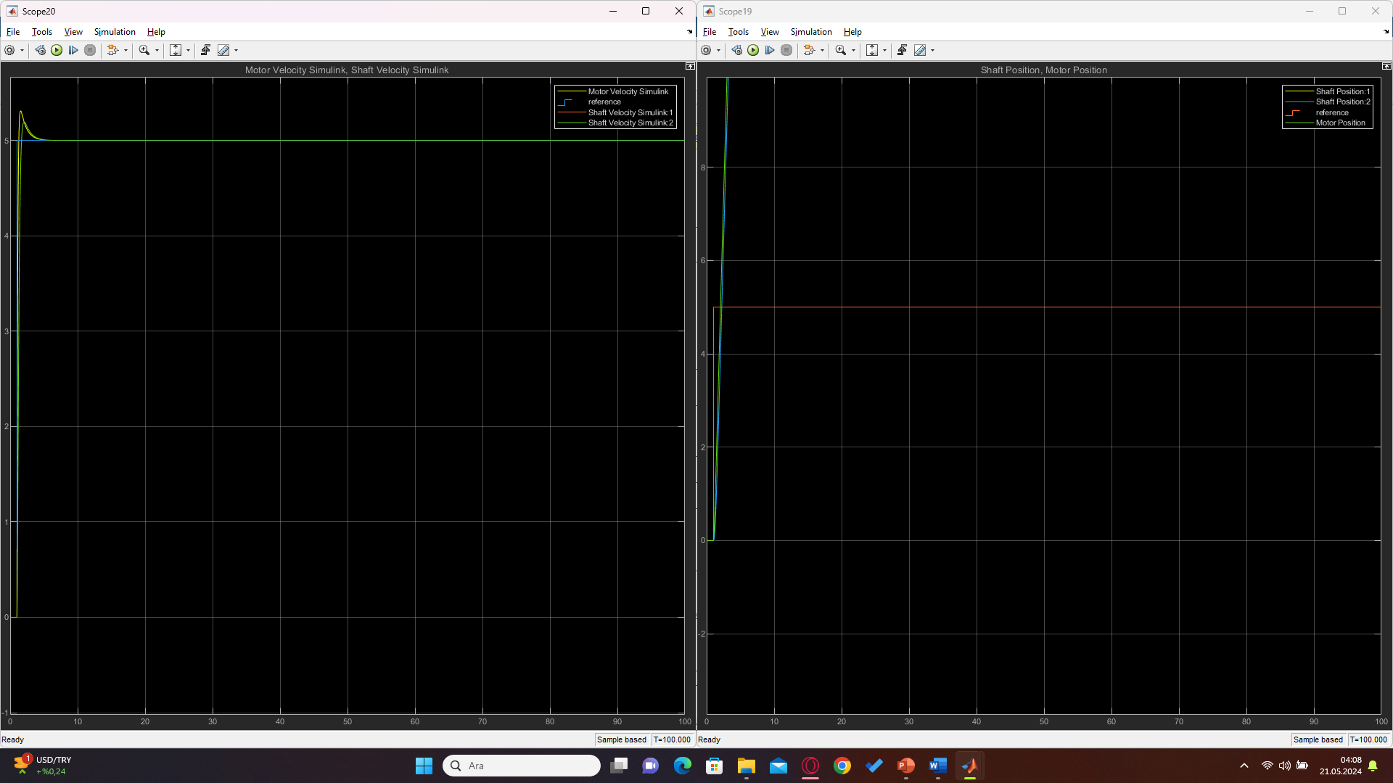
The graph of the velocity control system with a fixed input is given below.

Slide 15
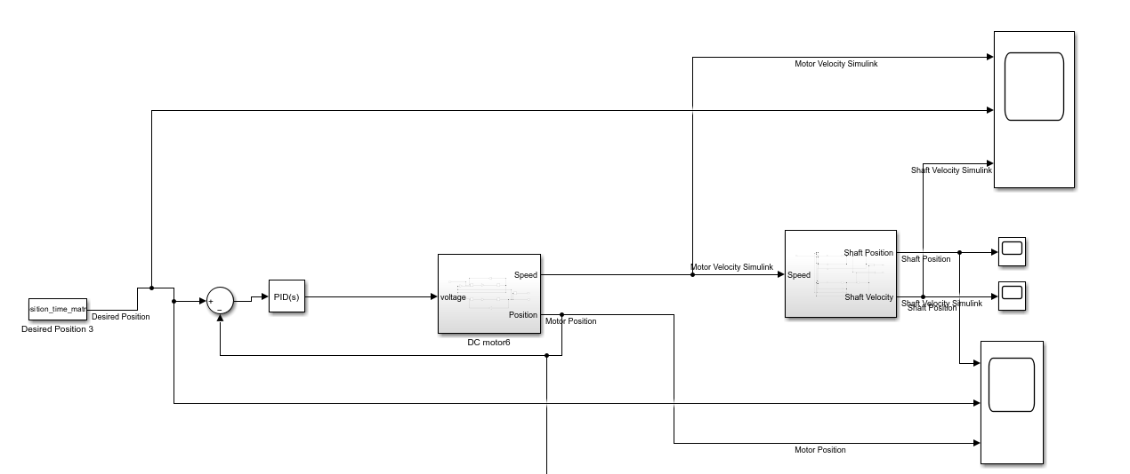
In the third case, the position is controlled with a desired position input.

Slide 16
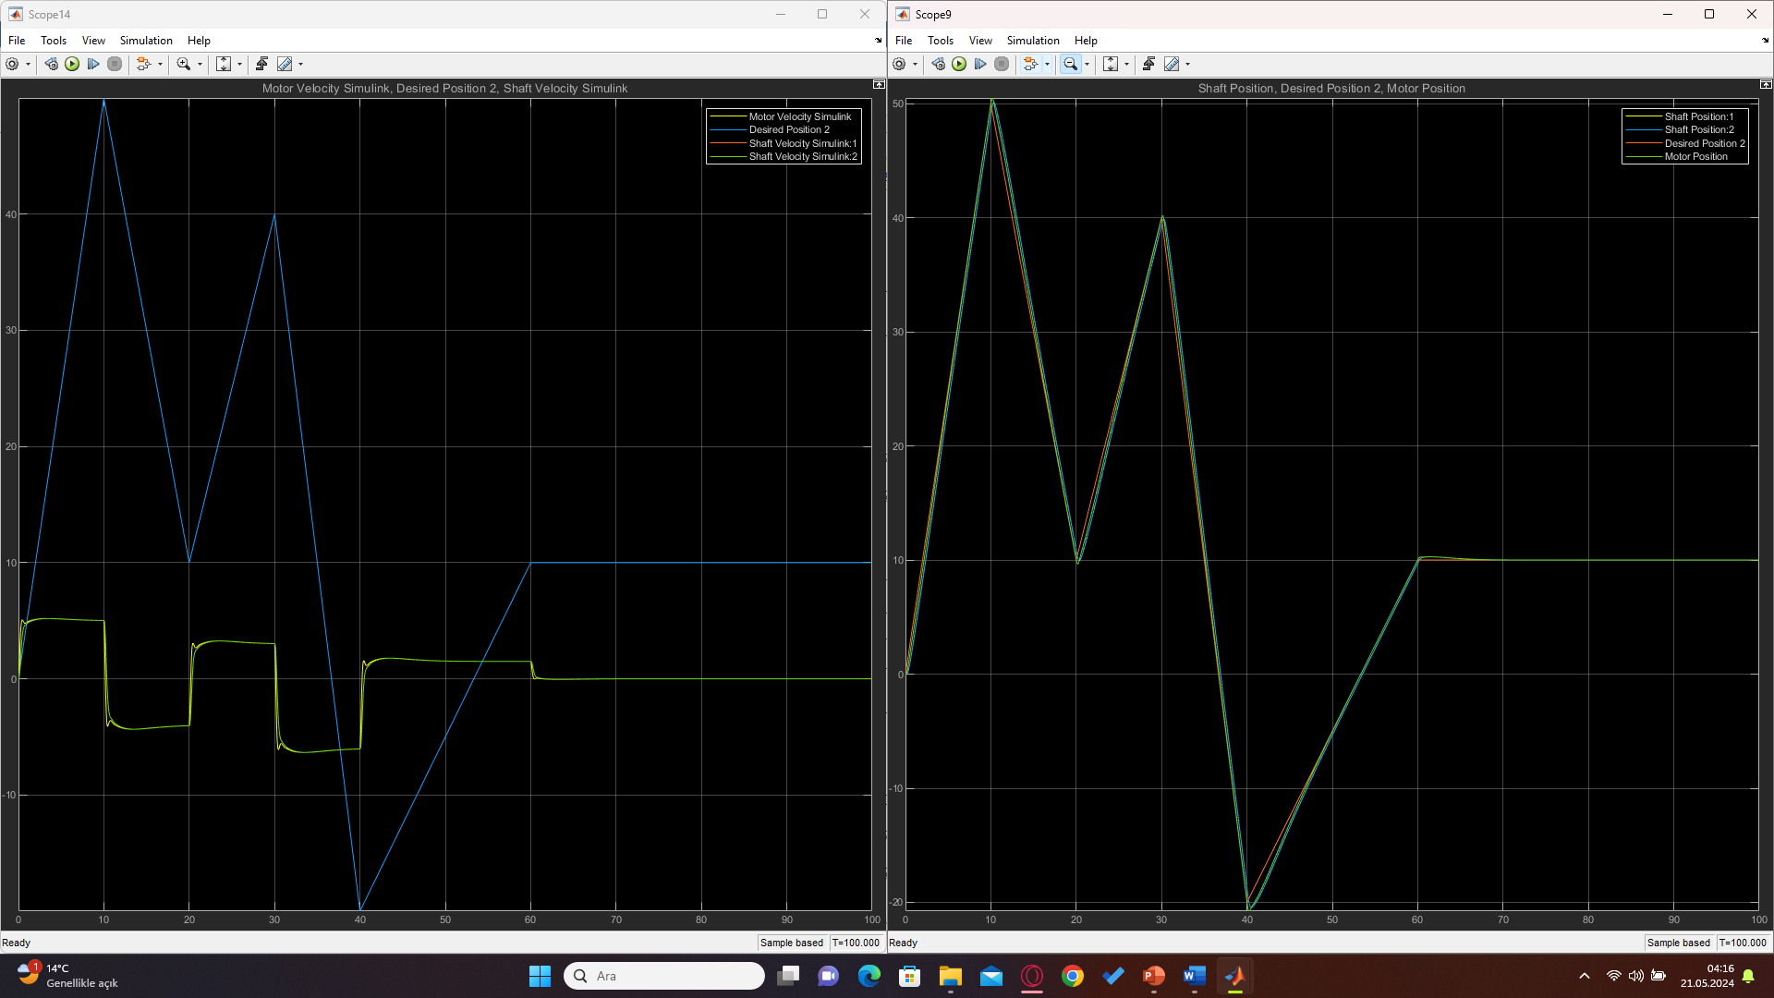
The graph of the position control system with a desired position input is given below.

Slide 17
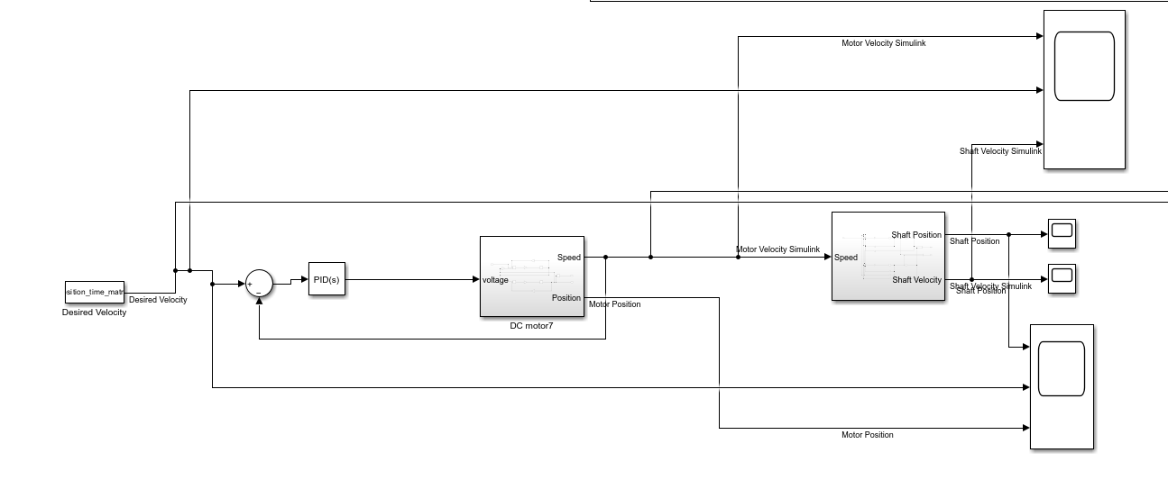
In the fourth case, the velocity is controlled with a desired velocity input.

Slide 18
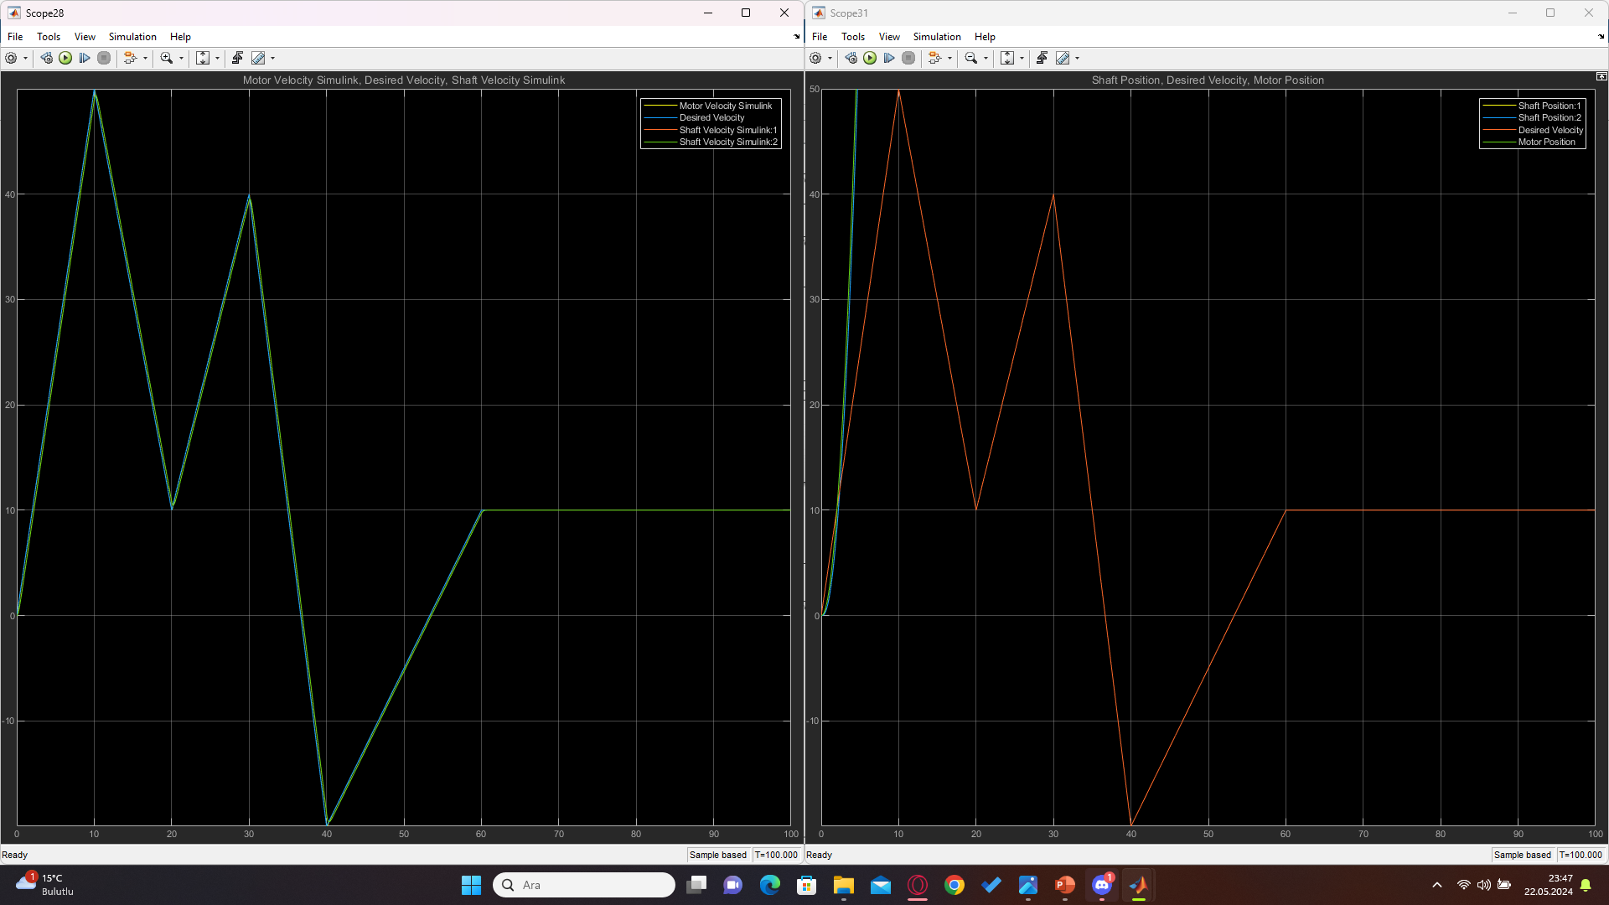
The graph of the velocity control system with a desired velocity input is given below.

Slide 19
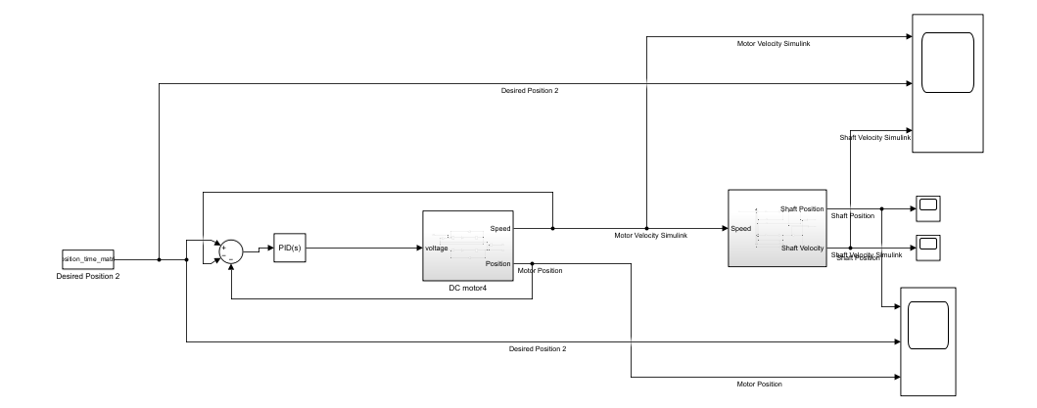
In the fifth case, the velocity and position are controlled with a desired velocity and position inputs.

Slide 20

The graph of the velocity and position control system with a desired velocity and position inputs is given below.

Slide 21
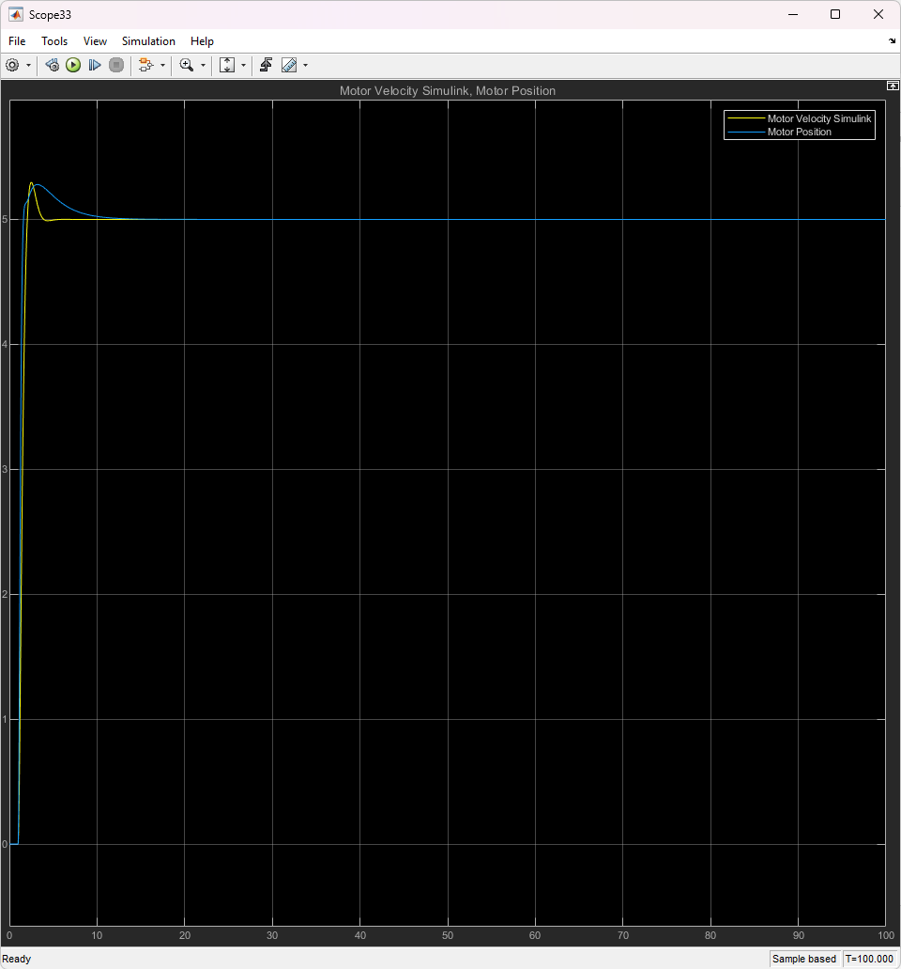
COMPARISON GRAPHS
The outputs of different position and speed controls at constant input are given on the side to compare and make sure.

Slide 22
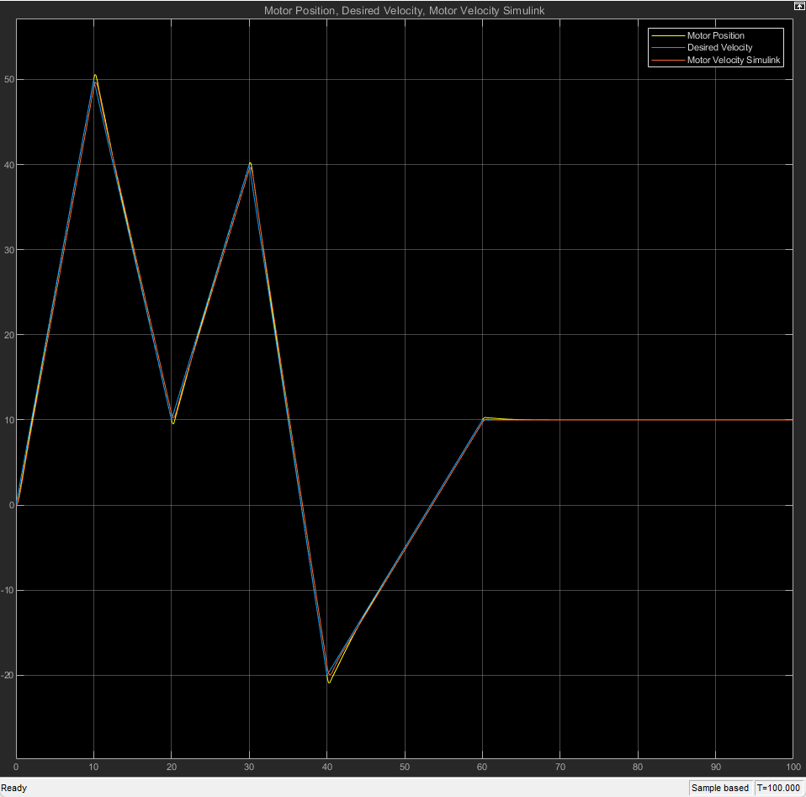
The outputs of different position and speed controls at the desired input are given on the side to compare and make sure.

Slide 23
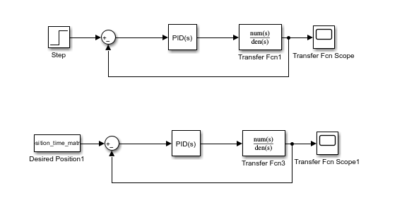
TRANSFER FUNCTION WITH PID AND GRAPHS
PID connection to the calculated transfer function of the system and controlled.

Slide 24
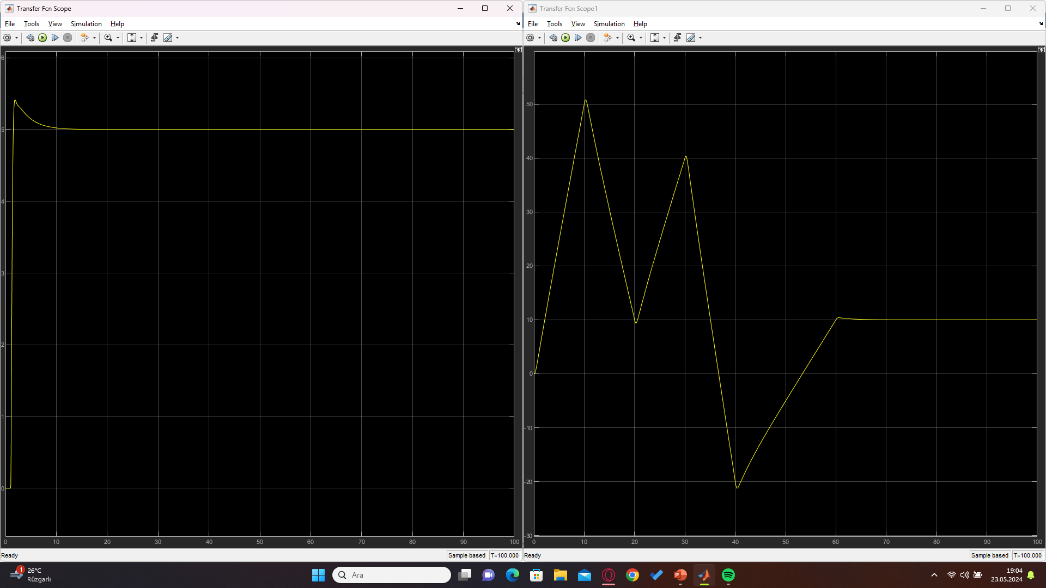
PID coupled transfer function graphs of fixed inputs and desired inputs are given.

Slide 25
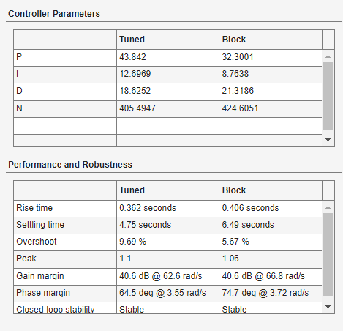
CONTROLLER PARAMETERS
The control parameters from the first system to the last system respectively are given.
The parameters of the first system are given on the next page.

Slide 26
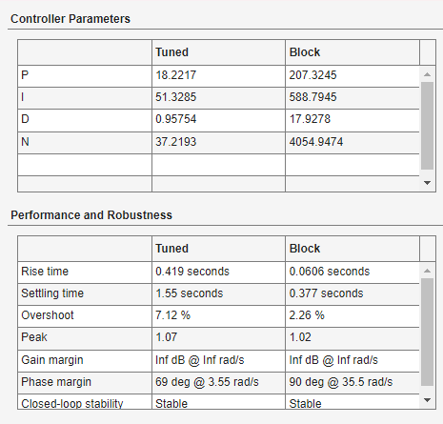
The parameters of the second system are given on the next page.

Slide 27
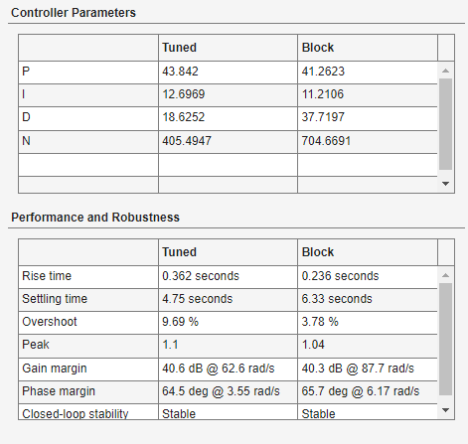
The parameters of the third system are given on the next page.

Slide 28
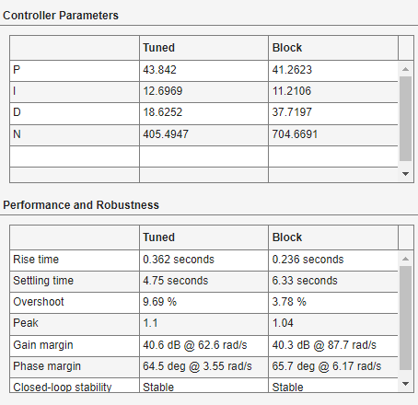
The parameters of the fourth system are given on the next page.

Slide 29
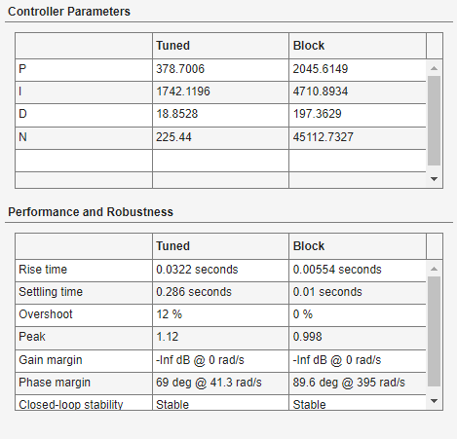
The parameters of the fifth system are given on the next page.

Slide 30
THANK YOU FOR LISTENING PATIENTLY.

